Slide 1
UNIT 5 (Part 2)- Range Image Processing

Slide 2
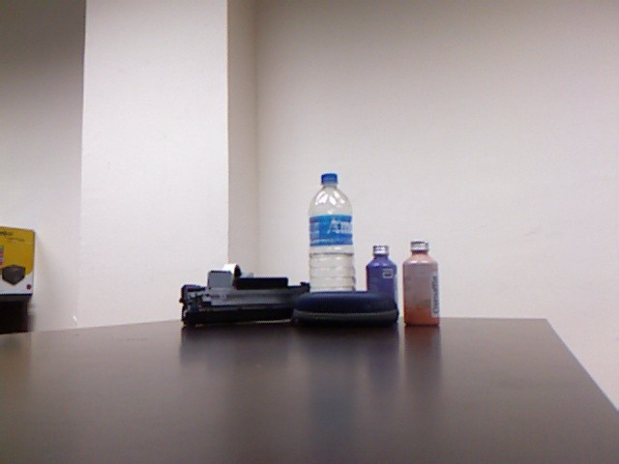
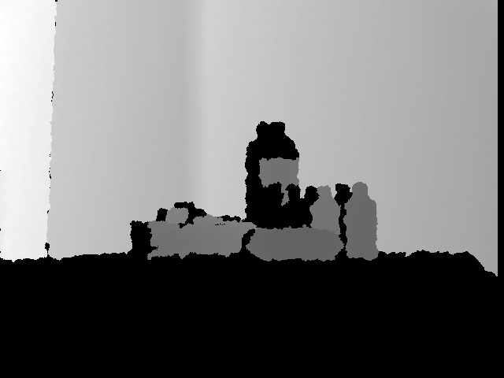
Range data
Range data is a 2-1/2 D or 3-D representation of the scene.
An image d(i, j), which records the distance d to the corresponding scene point (X, Y, Z) for each image pixel
(i, j).
It could be provided as a set of 3-D scene points (point cloud).
2

Slide 3
Imaging Techniques
Passive imaging.
Stereo imaging
Active range sensing
Time-of-flight sensors
Triangulation-based sensors
Structured Light

Slide 4
Active range sensors
Active range sensors are devices that use emitted energy, such as light or sound, to measure the distance between the sensor and an object.
These sensors are commonly used in various applications, including robotics, industrial automation, automotive systems, and more.
They work by emitting a signal, measuring the time it takes for the signal to bounce off an object and return, and then using this information to calculate the distance.

Slide 5
Time-of-Flight (ToF) Sensors
ToF sensors use light, typically infrared, to measure the time it takes for a light pulse to bounce off an object and return.
They provide accurate distance measurements and are used in applications like gesture recognition, augmented reality, and indoor navigation.

Slide 6
Time-of-Flight Range Sensors
Source and detector collocated.
t: Time taken to travel the forward and return path. v: speed of light in the
Use a moving mirror to scan the beam.
given medium.
Pulsed laser
Distance:
d: (v x t)/2
Laser-based time-of-flight range sensors: light detection and ranging (LIDAR) or laser radar (LADAR) sensors.
Limitation:
o the minimum observation time
thus limited by the minimum distance observable.

Slide 7
Triangulation-based Sensors
Triangulation-based active range sensors are a category of active sensors that determine the distance to an object by measuring the angle and position of the reflected signal.
Triangulation is a geometric principle used to calculate distances by forming a triangle between the sensor, the object, and the point of reflection.
These sensors are widely used in various applications, including industrial automation, 3D scanning, robotics, and more.

Slide 8



Triangulation based Sensors
Known for a predetermined
The camera and light source are calibrated.
scanning path of the beam.
Apply triangulation to get the 3D point.
(X,Y,Z)
(i,j)
(u,v)
Observed in camera.
Camera
A light source.
Yi-Chih Hsieh, Decoding structured light patterns for three-dimensional imaging systems, Pattern Recognition 34 (2001) 343-349 .

Slide 9
Imaging principle
Encoding the 3-D
position of projected ray.
Scan the ray in a predetermined calibrated path.
(X,Y,Z)
(i,j)
(u,v)
A light source.
Camera
Yi-Chih Hsieh, Decoding structured light patterns for three-dimensional imaging systems, Pattern Recognition 34 (2001) 343-349 .

Slide 10
Structured Light Sensors
These sensors project a structured pattern (such as grids or stripes) of light onto an object and use the deformation of the pattern on the object's surface to calculate distance.
They are commonly used in 3D scanning and industrial metrology.

Slide 11
Structured Light
Encoding the 3-D position of projected ray.
Project a strip or pattern.
Get 3-D positions of all the scene points lying on the projected strip.
(X,Y,Z)
(i,j)
(u,v)
Structured light
Camera
Yi-Chih Hsieh, Decoding structured light patterns for three-dimensional imaging systems, Pattern Recognition 34 (2001) 343-349 .

Slide 12
Range Data Segmentation
Range data segmentation is the task of segmenting (dividing) a range image, an image containing depth information for each pixel, into segments (regions), so that all the points of the same surface belong to the same region, there is no overlap between different regions and the union of these regions generates the entire image.
The goal of range data segmentation is to identify and isolate objects, obstacles, or distinct regions within the sensor's field of view for further analysis and decision-making.

Slide 13
There have been two main approaches to the range segmentation problem: region-based range segmentation and edge-based range segmentation.
1. Region-based range segmentation
Region-based range segmentation algorithms can be further categorized into two major groups: parametric model-based range segmentation algorithms and region-growing algorithms.
Algorithms of the first group are based on assuming a parametric surface model and grouping data points so that all of them can be considered as points of a surface from the assumed parametric model (an instance of that model).
Region-growing algorithms start by segmenting an image into initial regions. These regions are then merged or extended by employing a region growing strategy. The initial regions can be obtained using different methods, including iterative or random methods. A drawback of algorithms of this group is that in general they produce distorted boundaries because the segmentation usually is carried out at region level instead of pixel level.

Slide 14
Edge-based range segmentation
Edge-based range segmentation algorithms are based on edge detection and labeling edges using the jump boundaries (discontinuities).
They apply an edge detector to extract edges from a range image. Once boundaries are extracted, edges with common properties are clustered together.
The segmentation procedure starts by detecting discontinuities using zero-crossing and curvature values.
The image is segmented at discontinuities to obtain an initial segmentation.

Slide 15
At the next step, the initial segmentation is refined by fitting quadratics whose coefficients are calculated based on the Least squares method.
In general, a drawback of edge-based range segmentation algorithms is that although they produce clean and well defined boundaries between different regions, they tend to produce gaps between boundaries.
In addition, for curved surfaces, discontinuities are smooth and hard to locate and therefore these algorithms tend to under-segment the range image. Although the range image segmentation problem has been studied for a number of years, the task of segmenting range images of curved surfaces is yet to be satisfactorily resolved.

Slide 16
Range Image Registration
Range image registration is the process of aligning and combining multiple range images, which may be captured from different viewpoints or at different times, to create a single, coherent 3D model. The key steps involved in range image registration include:
Feature Extraction: Extract features or keypoints from the range images. These features serve as distinctive points that can be matched across different images.
Feature Matching: Match corresponding features in pairs of range images to establish their relative pose (position and orientation) with respect to each other.
Pose Estimation: Calculate the transformation (usually translation and rotation) that aligns the range images accurately. Common algorithms for this purpose include Iterative Closest Point (ICP) and its variants.
Global Registration: Combine the relative transformations to register all range images into a common global coordinate system.
Refinement: Fine-tune the alignment to minimize any residual errors or misalignments.
Data Fusion: Merge the registered range images into a single, unified 3D model.

Slide 17
Model Acquisition:
Model acquisition is the process of creating a 3D model from the registered range images. This representation can take the form of a point cloud, a mesh, or other 3D data structures. The typical steps in model acquisition include:
Point Cloud Generation: Convert the registered range images into a 3D point cloud, where each point corresponds to a 3D coordinate in space and includes depth information from the range data.
Mesh Generation: In some applications, a 3D mesh is generated from the point cloud, often consisting of interconnected triangles. This mesh can provide a more detailed and structured representation of the 3D model.
Texture Mapping: Apply color or texture information to the 3D model, typically using images or textures captured in conjunction with the range data.
Mesh Simplification: For real-time rendering and storage efficiency, reduce the complexity of the 3D model by simplifying the mesh while preserving important geometric features.
Texture Projection: Project textures from the original images onto the 3D model to enhance its appearance and realism.
Post-Processing: Perform various data cleaning, noise reduction, hole filling, and optimization tasks to ensure that the 3D model is suitable for its intended application.

Slide 18
Object Recognition
Object recognition is a computer vision technique for identifying objects in images or videos. Object recognition is a key output of deep learning and machine learning algorithms.
When humans look at a photograph or watch a video, we can readily spot people, objects, scenes, and visual details.
The goal is to teach a computer to do what comes naturally to humans: to gain a level of understanding of what an image contains.

Slide 19
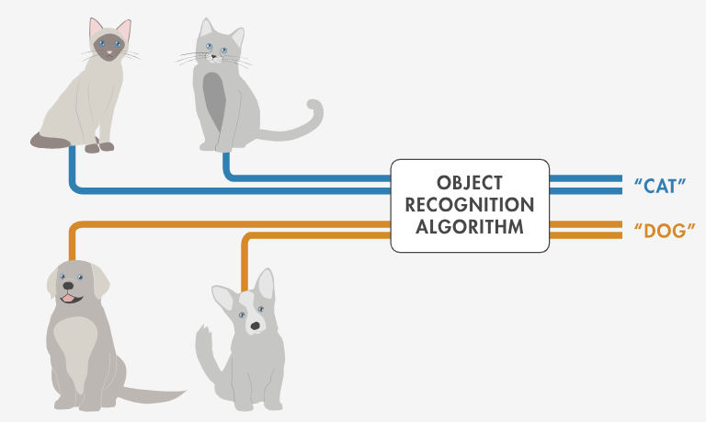
Object recognition is a key technology behind driverless cars, enabling them to recognize a stop sign or to distinguish a pedestrian from a lamppost. It is also useful in a variety of applications such as disease identification in bioimaging, industrial inspection, and robotic vision.

Slide 20
Object recognition typically consists of several key steps:
Object Detection:
Localization: Determine the location and extent of objects within an image. This is often done by drawing bounding boxes around the objects.
Class Labeling: Assign a label or category to each detected object (e.g., "car," "person," "dog").
2. Feature Extraction: Extract distinctive features from the detected objects. Common features include color, texture, shape, and key points.
3. Feature Representation: Transform the extracted features into a suitable format for further analysis. This often involves creating feature vectors or descriptors that capture the essential characteristics of the object.
4. Classification: Use machine learning algorithms, such as deep neural networks (e.g., CNNs), support vector machines (SVMs), or decision trees, to classify objects based on their feature representations.
5. Recognition and Decision-Making: Determine the identity of recognized objects based on the classification results. This may involve associating objects with known object categories or labels.
6. Post-Processing: Enhance the recognition results by applying additional techniques, such as non-maximum suppression to remove redundant bounding boxes or smoothing techniques to improve object tracking.

Slide 21
How Object Recognition Works
You can use a variety of approaches for object recognition. Recently, techniques in machine learning and deep learning have become popular approaches to object recognition problems. Both techniques learn to identify objects in images, but they differ in their execution.

Slide 22
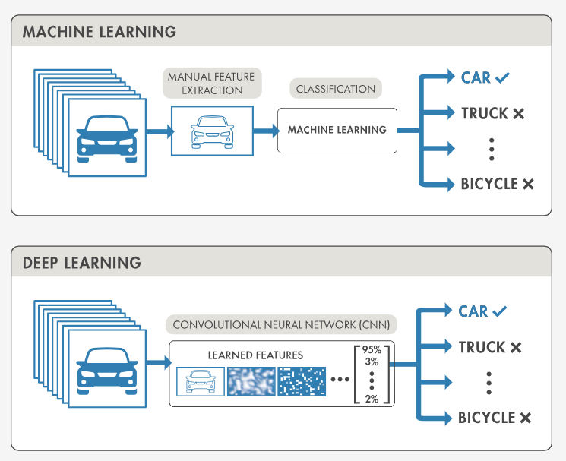

Slide 23
Object Recognition Using Deep Learning
Deep learning techniques have become a popular method for doing object recognition. Deep learning models such as convolutional neural networks, or CNNs, are used to automatically learn an object’s inherent features in order to identify that object.
For example, a CNN can learn to identify differences between cats and dogs by analyzing thousands of training images and learning the features that make cats and dogs different.

Slide 24
There are two approaches to performing object recognition using deep learning:
Training a model from scratch: To train a deep network from scratch, you gather a very large labeled dataset and design a network architecture that will learn the features and build the model. The results can be impressive, but this approach requires a large amount of training data, and you need to set up the layers and weights in the CNN.
Using a pretrained deep learning model: Most deep learning applications use the transfer learning approach, a process that involves fine-tuning a pretrained model. You start with an existing network, such as AlexNet or GoogLeNet, and feed in new data containing previously unknown classes. This method is less time-consuming and can provide a faster outcome because the model has already been trained on thousands or millions of images.
Deep learning offers a high level of accuracy but requires a large amount of data to make accurate predictions.

Slide 25
Machine learning techniques for object recognition
Machine learning techniques are also popular for object recognition and offer different approaches than deep learning. Common examples of machine learning techniques are:
HOG feature extraction with an SVM machine learning model
Bag-of-words models with features such as SURF and MSER (Maximally Stable External Regions)
The Viola-Jones algorithm, which can be used to recognize a variety of objects, including faces and upper bodies

Slide 26
Machine Learning vs. Deep Learning for Object Recognition
The main consideration to keep in mind when choosing between machine learning and deep learning is whether you have a powerful GPU and lots of labeled training images.
If the answer to either of these questions is No, a machine learning approach might be the best choice.
Deep learning techniques tend to work better with more images, and a GPU helps to decrease the time needed to train the model.

Slide 27
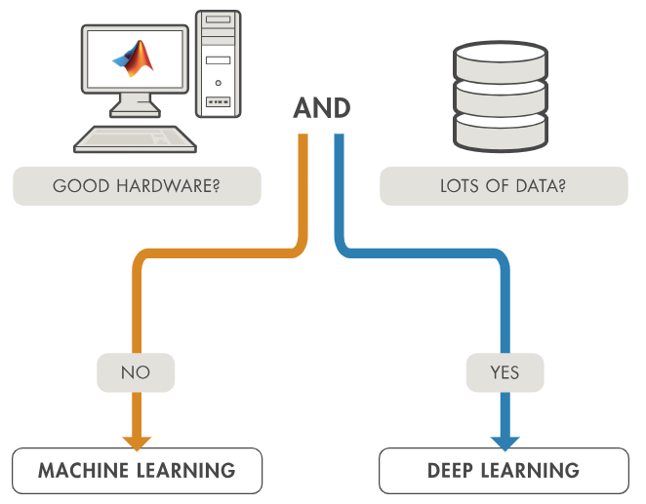

Slide 28
Thank you!

